Slide 1

Netflix Content Trends Analysis for Strategic Recommendations
Vaibhav Namdev Admane Internship ID:INTERNSHIP_17546440516895be537820f

Slide 2

PROBLEM STATEMENT
The Challenge: Netflix needs to strategically analyze its vast content library to understand evolving trends, identify strengths and gaps, and make data-driven decisions for content acquisition and production to stay competitive.
Project Objectives:
Analyze the distribution of Movies vs. TV Shows over the years.
Identify the most common genres and how their popularity has changed over time.
Compare country-wise contributions to the Netflix catalog to understand global strategy.

Slide 3
Project Description
This project performs an end-to-end analysis of the Netflix dataset, which contains details on over 7,700 movies and TV shows.
The goal is to uncover actionable insights into Netflix's content strategy by exploring three core areas:
The balance between movies and TV shows.
The most dominant content genres.
The geographical distribution of its content library.
By cleaning the data, performing exploratory analysis, and creating visualizations, this project aims to provide clear, data-backed recommendations for future content decisions.

Slide 4

WHO ARE THE END USERS?
The insights from this analysis are intended for internal teams at Netflix to inform strategic decisions.
Content Strategy & Acquisition Teams: To identify popular, rising, or underserved genres and regions for new content investment.
Marketing & Regional Teams: To understand local preferences and tailor marketing campaigns effectively in key markets.
Business Executives & Decision-Makers: To get a high-level overview of content performance and global market penetration.

Slide 5

Technology Used
This analysis was conducted using Python and several key data science libraries:
Python: The core programming language for the analysis.
Pandas: For data loading, cleaning, and manipulation.
NumPy: For efficient numerical computations.
Matplotlib & Seaborn: For creating static visualizations like line charts, bar charts, and stacked bar charts.
Plotly Express: For generating the interactive choropleth world map.
Jupyter Notebook: As the interactive environment for coding and analysis.

Slide 6
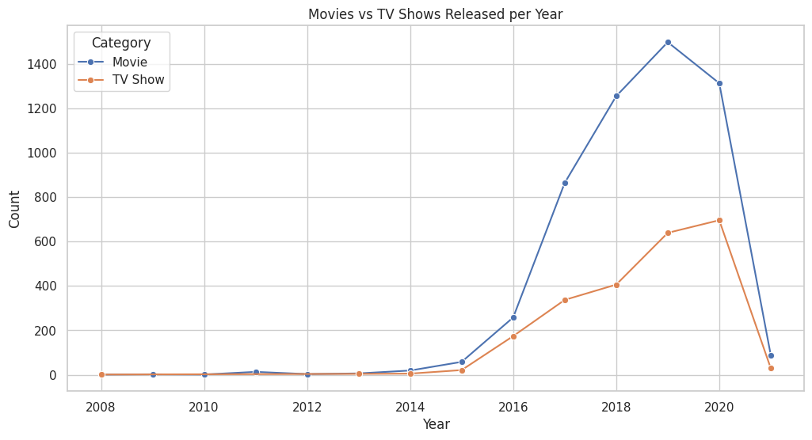
RESULTS 1 - Movies vs. TV Shows
Key Insight: While Movies have historically dominated the Netflix library, the production of TV Shows has accelerated dramatically, especially after 2015, indicating a strategic shift towards episodic content.

Slide 7
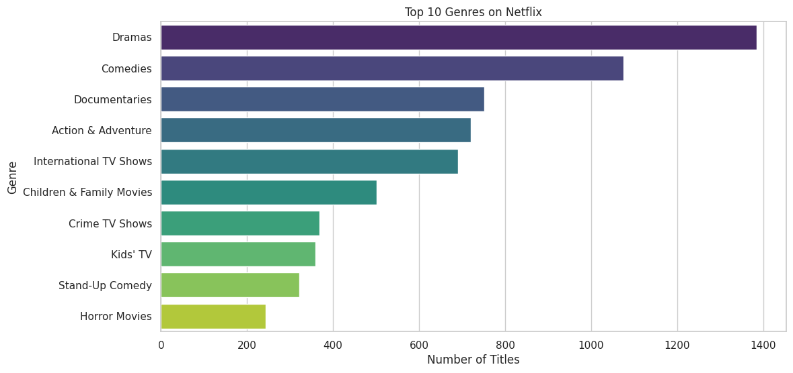
RESULTS 2 - Top Genres and Countries
Key Insights: International Movies, Dramas, and Comedies are the top three genres, making up a substantial portion of the Netflix catalog.

Slide 8
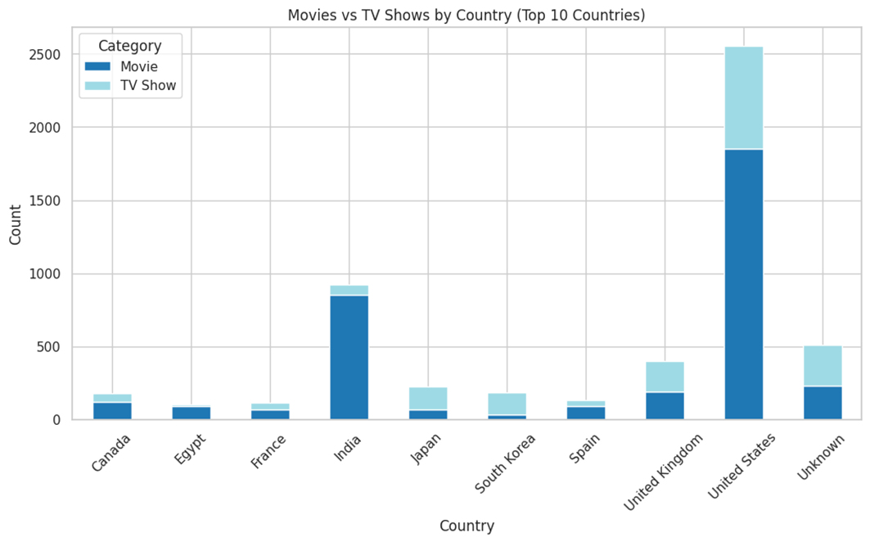
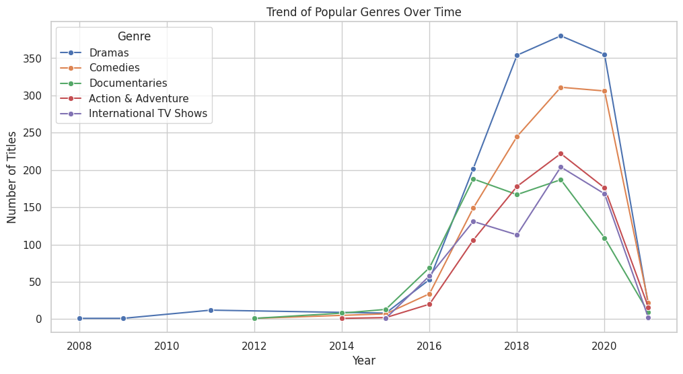
RESULTS 3 - Strategic Focus
Key Insights: Deeper analysis shows how genre preferences vary by country and which genres are trending over time.

Slide 9
GitHub repository
Vaibhav-153/VOIS_AICTE_Oct2025_MajorProject_VaibhavAdmane

Slide 10
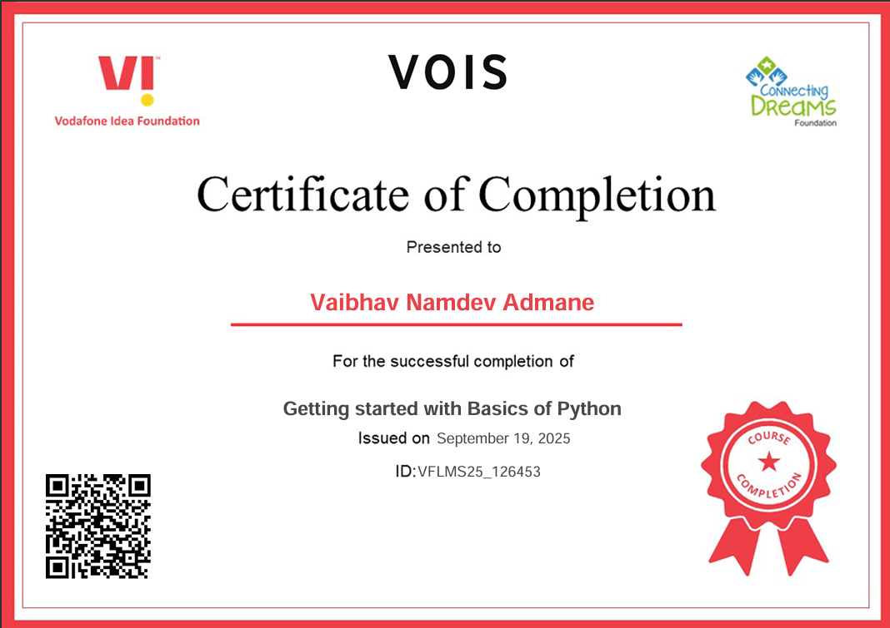
Getting started with Basics of Python Certificate

Slide 11
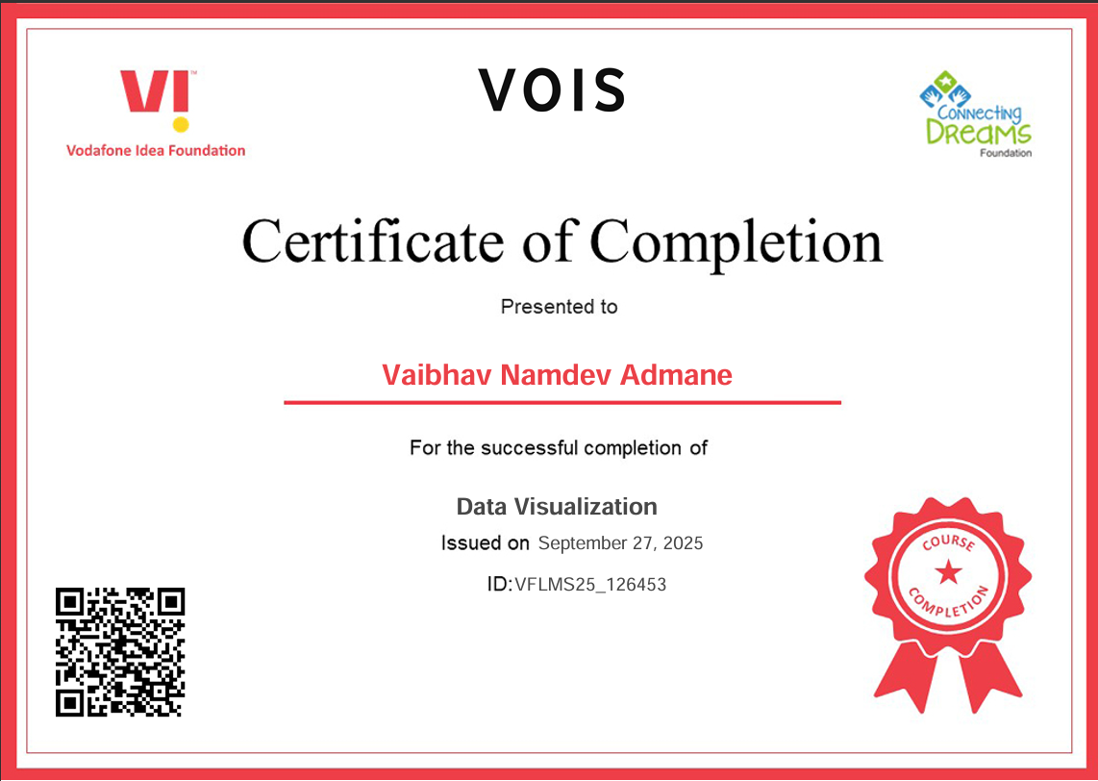
Data Visualization Certificate

Slide 12
Thank you
.
.

